Slide 1
Motivation, Goals and Definitions

Slide 2
Why do we test?

Slide 3
Some Reasons to Test
Software is built by humans, humans are fallible consequently software is fallible
Any non-trivial program will have faults
Testing helps identify defects (bugs)
After identifying bugs we can attempt to fix them and then improve the quality – testing in and of its self does not improve quality

Slide 4
MS Visual Studio Online Outage
August 2014 – Over five hours of outage
Quote about the failure of a major service that Microsoft provides
"Unless you completely rewrite and refactor the software to get rid of the legacy completely, [that complexity] is always there," Miller said. "As a result, any time you short-circuit testing, and assume that unit testing of just the new feature covers everything, you'll eventually discover that it doesn't. Unit testing" is pretty much what it sounds like: The practice of testing discrete units of code, not the whole, to see if things work. ”
http://www.networkworld.com/article/2598886/cloud-computing/customers-praise-microsofts-no-bs-explanation-of-cloud-service-outage.html

Slide 5
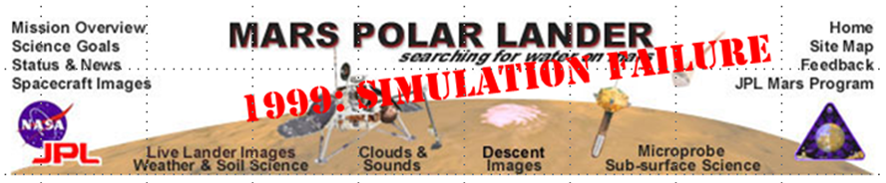
Notable Failures #1
NASA's Mars Polar Lander in 1999
Communication with the spacecraft was lost as the spacecraft went into orbital insertion, due to ground-based computer software which produced output in non-SI units of pound-seconds (lbf×s) instead of the metric units of newton-seconds (N×s) specified in the contract between NASA and Lockheed. The spacecraft encountered Mars on a trajectory that brought it too close to the planet, causing it to pass through the upper atmosphere and disintegrate
$190 Million

Slide 6
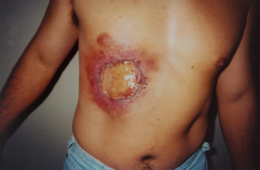
Notable Failures #2
Therac-25 radiation therapy machine
The accidents occurred when the high-power electron beam was activated instead of the intended low power beam, and without the beam spreader plate rotated into place. Previous models had hardware interlocks in place to prevent this, but Therac-25 had removed them, depending instead on software interlocks for safety. The software interlock could fail due to a race condition. The defect was as follows: a one-byte counter in a testing routine frequently overflowed; if an operator provided manual input to the machine at the precise moment that this counter overflowed, the interlock would fail.
The high-powered electron beam struck the patients with approximately 100 times the intended dose of radiation, delivering a potentially lethal dose of beta radiation. The feeling was described by patient Ray Cox as "an intense electric shock", causing him to scream and run out of the treatment room.[3] Several days later, radiation burns appeared and the patients showed the symptoms of radiation poisoning; in three cases, the injured patients later died.
See this for analysis http://www.ironiacorp.com/apps/wiki/testing/Therac_25
Human Life

Slide 7
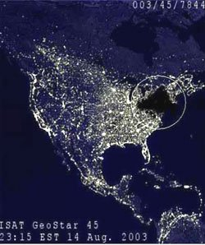
Notable Failures #3
Northeast blackout of 2003
55,000,000 people affected
10 deaths
According to the task force, FirstEnergy 's Alarm and Event Processing Routine (AEPR), a key software program that gives operators visual and audible indications of events occurring on their portion of the grid, began to malfunction. As a result, "key personnel may not have been aware of the need to take preventive measures at critical times, because an alarm system was malfunctioning."
Human Life
$5 Billion

Slide 8
The economics of bugs
A study conducted by NIST in 2002 reports that software bugs cost the U.S. economy $59.5 billion annually. More than a third of this cost could be avoided if better software testing was performed.

Slide 9
Knight Capital Group
Reported August 3, 2012 (Bloomberg)
Knight Capital Group Inc., one of the biggest U.S. market makers for stocks, struggles to survive a software bug that triggered a $440 million loss

Slide 10
Mariner 1 Spacecraft
$18,000,000
The Mariner 1 spacecraft, on a Venus flyby mission in 1962, barely made it past Cape Canaveral when a software-coding error caused the rocket to veer dangerously off-course, threatening to crash back to earth. Alarmed NASA engineers on the ground issued a self-destruct command less than 5 minutes after takeoff. A review board later determined that the omission of a hyphen in coded computer instructions allowed the transmission of incorrect guidance signals to the spacecraft. The cost for the rocket was reportedly more than $18 million at the time.

Slide 11
$3 Billion Toyota Error
When Toyota recalled more than 400,000 of its hybrid vehicles in 2010, it wasn't because of a mechanical issue. The cars, including Toyota's Prius line, had a software glitch, which would cause a lag in the anti-lock-brake system. The news came at a time when Toyota had come under scrutiny for safety issues related to physical defects in millions of other cars it had made. Class-action lawsuits resulting from those recalls, including the software glitch, were estimated to cost Toyota as much as $3 billion.

Slide 12
Defect correction is important
Dollar cost
To identify the defects
To fix the defects
Impact of the defects
Reputation cost
Reduced confidence of customers
Frustration of customers
Lives of users

Slide 13
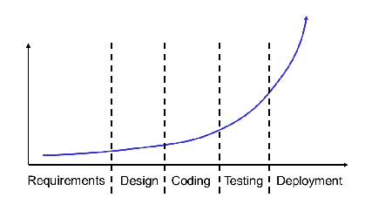
Cost increase of finding bugs
The later a defect is found the more costly it is to fix it

Slide 14
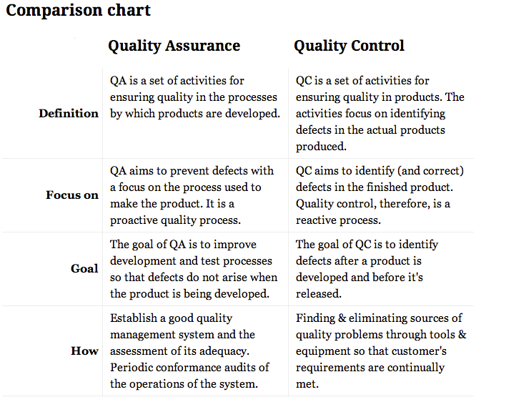
Definitions – QA and QC

Slide 15
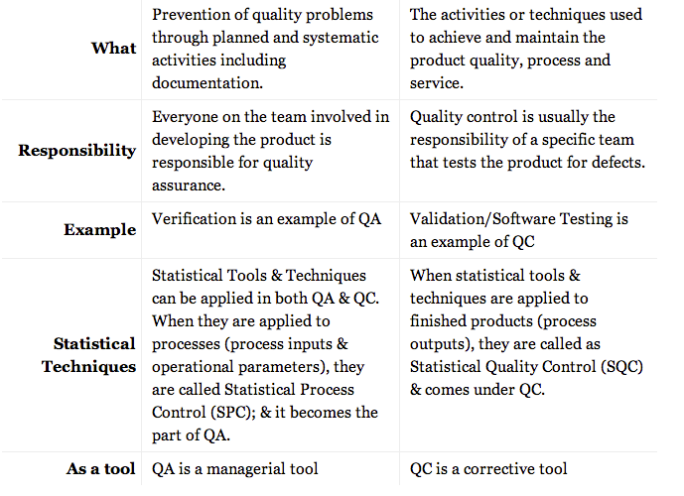
QA/QC Continued

Slide 16
Common Terms
Test Plan – A managerial document to assess risk and plan mitigation strategies. It outlines testing strategies and quality goals.
Test Case – A specific test scenario made up of one or more test scripts.
Test Script – A sequence of actions and expected outcomes. Includes any preparation steps.
Fault – A latent error in the software waiting to be manifest through specific usage scenarios
Defect (bug) – A manifestation of a fault through a specific usage sequence
Repro – Short for reproducible. The steps and expected outcome to show a defect.
IV&V – Independent verification and validation

Slide 17
Common Types of Testing
Unit – Class and method level testing usually by the developer
Integration – Class collaboration testing by developers or dedicated testers
System – End to end testing done by technical staff (devs and/or testers)
Acceptance – End to end testing done by the users
Regression – Repeating tests to ensure a fix or fixes didn’t break anything
Performance – Ensure that the product meets performance and peak usage expectations
Load – Where is the breaking point and what are the effects. Typically beyond expected max volumes.
Security – Attempts to identify security vulnerabilities

